Slide 1
Habit 4: Think Win-Win

Slide 2
Win-Lose
Getting ahead at the expense of others
Putting others down so you feel better
Always getting your way no matter what
Becoming jealous/envious of others

Slide 3
Lose-Win
Always being the one to cave in
Not standing up for your principles
Giving into peer pressure
Always compromising your standards

Slide 4
Lose-Lose
If I can’t have it, no one can mentality
Revenge plots
Codependency

Slide 5
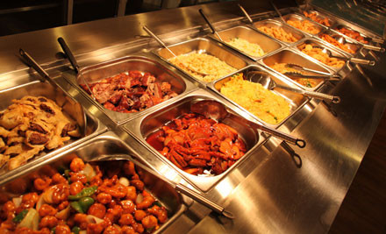
Win-Win
Caring about yourself AND others
Compromising, but not sacrificing your standards
Being secure enough to not compete or compare with others

